Slide 1

YOLO 8 and ChatGPT
Differentiating Royalty vs Students
Group Members : Allan Muir, Justin An, Uzma Amir, Oshin Wilson, Tanjee Afreen , Patrick Adegabaye
Professor : Dr. Yu
Date : November 21,2024

Slide 2
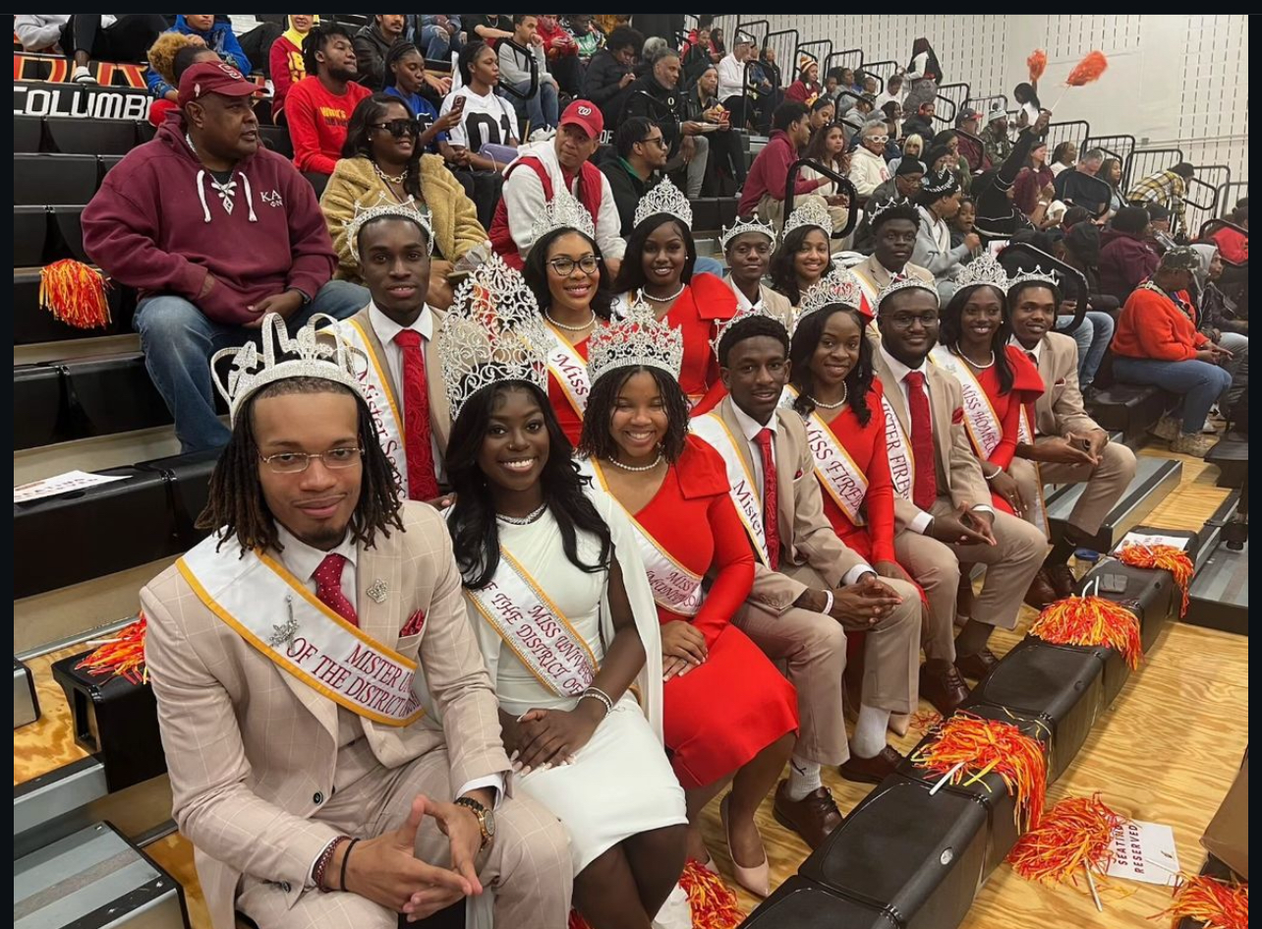
Goal
The goal is to develop an AI system capable of recognizing individual students on campus. This will help with attendance. Additionally, it should accurately distinguish whether a student is a member of the royal court by identifying visual markers, such as a crown or a sash.

Slide 3
Method
YOLO8 Architecture – Feature Pyramid Networks (FPN) & Path Aggregation Networks (PAN) for multi-scale detection.
Loss Function – The generalized loss function combines bounding box, classification, and distribution focal losses, optimized using stochastic gradient descent with momentum and weight decay.
Evaluation Metrics- Mean average precision (mAP) was the primary metric, emphasizing small object detection, occlusion handling, and class distinction.

Slide 4
Reference
Reis, D., Kupec, J., Hong, J., & Daoudi, A. (2024, May 22). Real-time flying object detection with yolov8. arXiv.org. https://arxiv.org/abs/2305.09972
Video – https://www.youtube.com/watch?v=syWa2WAVTM0

